Slide 1
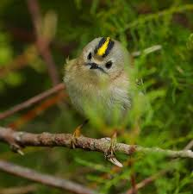
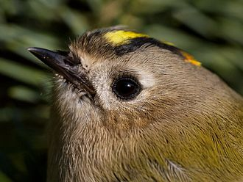
Goldcrest
Sirle Puusta

Slide 2
Size
The goldcrest is the smallest European bird
8.5–9.5 cm in length
with a 13.5–15.5 cm wingspan
and a weight of 4.5–7.0 g

Slide 3
Appearance
Goldcrest has olive-green upper-parts
buff-white underparts
two white wing bars
a plain face with conspicuous black irises.

Slide 4
Appereance
The crown of the head has black sides and a narrow black front, and a bright crest, yellow with an orange centre in the male...

Slide 5
Appearance
... and entirely yellow in the female

Slide 6
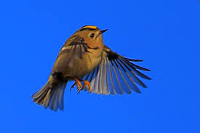
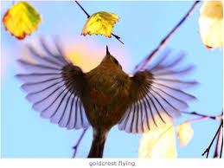
Flight
The flight is distinctive; it consists of whirring wing-beats with occasional sudden changes of direction. Shorter flights while feeding are a mix of dashing and fluttering with frequent hovering. It moves restlessly among foliage, regularly creeping on branches and up and down trunks.
Watch goldcrest slow motion https://www.youtube.com/watch?v=6_SZEVX7U1g
Read more and watch goldcrest motion by Karl Adami http://www.looduskalender.ee/vana/en/node/25692.html

Slide 7
Song
The song of the male goldcrest is a very high, thin double note cedar, repeated 5–7 times and ending in a flourish, cedarcedar-cedar-cedar-cedar-stichi-see-pee.The entire song lasts 3–4 seconds and is repeated 5–7 times a minute.
https://naturesoundscapes.eu/track/p-ialpoiss-goldcrest

Slide 8
Interesting to know
At old age we are not able to hear such high notes anymore as goldcrest voice. Elderly people would not hear its song even when it sings next to one. So goldcrest song can be a criteria in evaluating hearing.

Slide 9
Habitat
The goldcrest has a huge range in Eurasia, breeding from Macaronesia to Japan.
Further east it occurs discontinuously through southern Siberia to Sakhalin and Japan, in the Tian Shan mountains, northern Iran, and from the Himalayas east to central China.

Slide 10
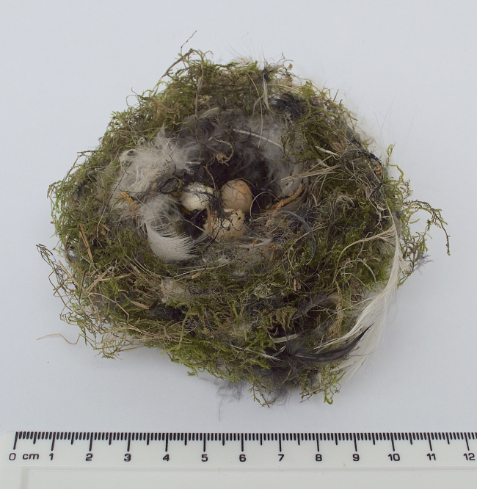
Breeding
Usually builds its nest to spruce and quite high, up to 7-14 meters.
Nest is a well-insulated cup-shaped structure
The eggs are whitish with very indistinct buff, grey or brown markings at the broad end.

Slide 11
Feeding
All Regulus species are almost exclusively insectivorous, preying on small arthropods with soft cuticles, such as springtails, aphids and spiders. They also feed on the cocoons and eggs of spiders and insects, and occasionally take pollen.
The goldcrest takes a wide variety of prey, especially spiders, caterpillars, bugs, springtails and flies. Larger prey such as oak bush crickets and tortrix moths may sometimes be taken.

Slide 12
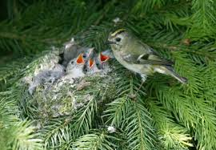
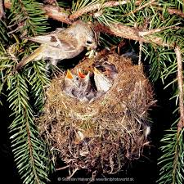
Status
The goldcrest has a large range, estimated at 13.2 million km2 and a total population estimated at 80–200 million individuals, and it is therefore classed as least concern on the IUCN Red List.

Slide 13
Useful facts
Goldcrest is a national bird on Luxembourg

Slide 14
Thank you!

